Slide 1
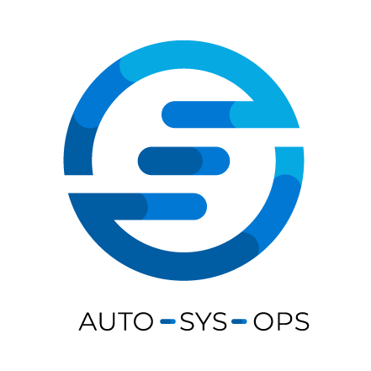
Improve security
with your own PSGallery

Slide 2

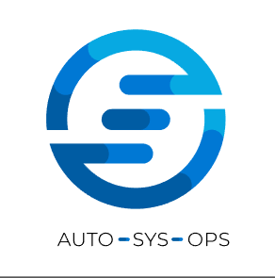

Introduction
Who am I?
Cloud Consultant @ OGD-ict diensten
IAC, CI/CD, Automation, Agile, DevOps
Previous experiences:
Technical Lead SysOps Team
SysOps Engineer
Functional Application Specialist
PHP Backend Developer
Twitter: @AutoSysOps Blog: www.autosysops.com

Slide 3
Introduction
Agenda
What to be afraid of?
How bad is it?
What can we do?
Demo time!
Questions

Slide 4
What to be afraid of?
Common attacks

Slide 5
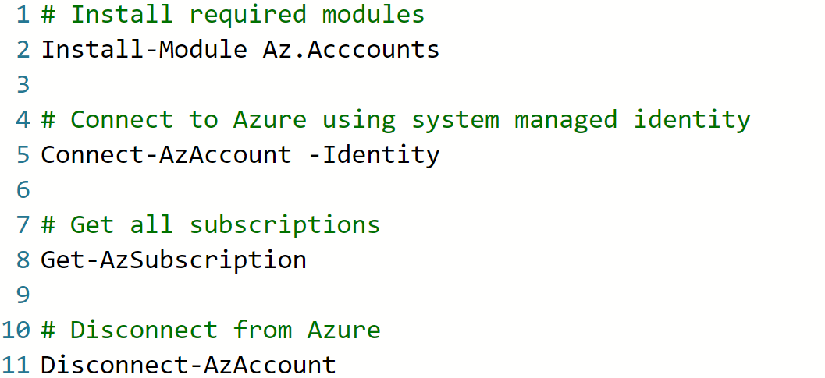

What to be afraid of
Can you spot the error?

Slide 6
What to be afraid of
Can you spot the error?
-Repository PSGallery

Slide 7
What to be afraid of
Can you spot the error?
-Repository PSGallery

Slide 8
How bad is it?
Am I going to be fired?

Slide 9
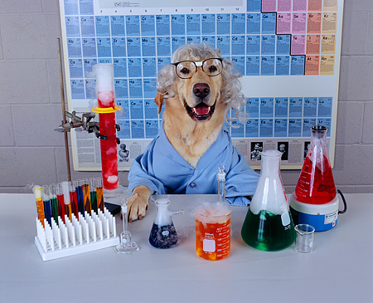
How bad is it?
Let’s find out!

Slide 10
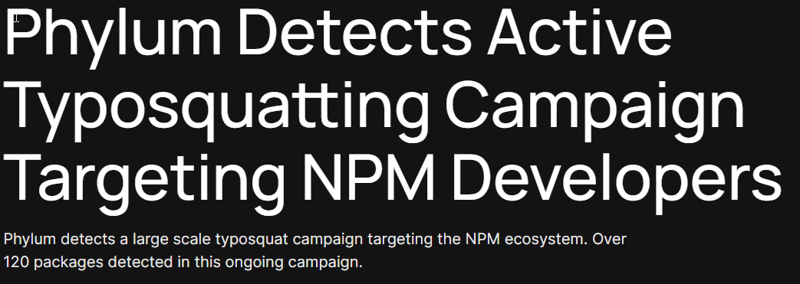
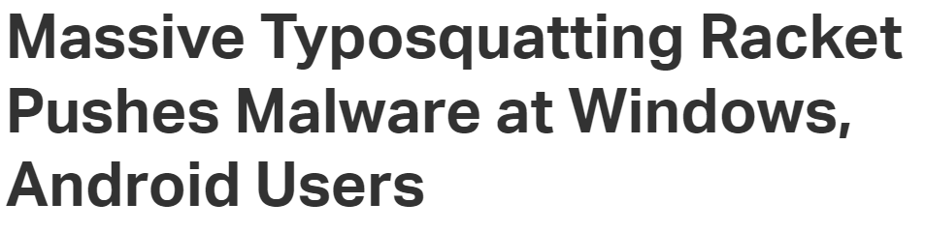
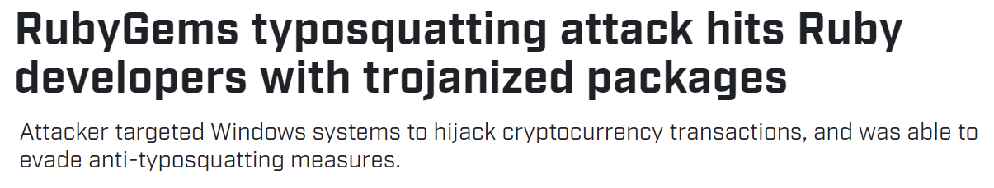
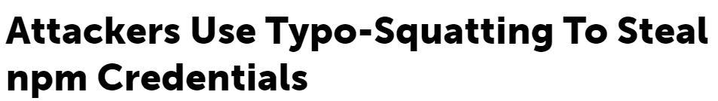
How bad is it?

Slide 11
How bad is it?
Typosquatting?
Uses public repositories
Generators available
Can go undetected easily
https://support.microsoft.com/en-us/topic/what-is-typosquatting-54a18872-8459-4d47-b3e3-d84d9a362eb0 https://blogs.microsoft.com/on-the-issues/2010/04/15/the-trouble-with-typosquatting/

Slide 12
How bad is it?
Is powershell vulnerable?
Many modules are standalone

Slide 13
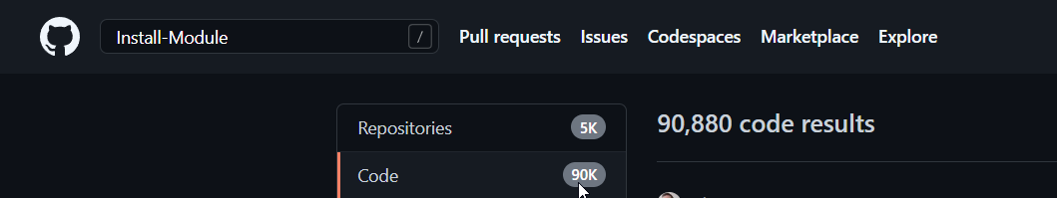
How bad is it?
Is powershell vulnerable?
Many modules are standalone
But ….
Many scripts have dependencies

Slide 14


How bad is it?
Is powershell vulnerable?
Developer looks up issue

Slide 15
How bad is it?
Is powershell vulnerable?
Developer looks up issue
Internet provides script

Slide 16

How bad is it?
Is powershell vulnerable?
Developer looks up issue
Internet provides script
Test if code works locally

Slide 17

How bad is it?
Is powershell vulnerable?
Developer looks up issue
Internet provides script
Download dependencies
Test if code works locally

Slide 18
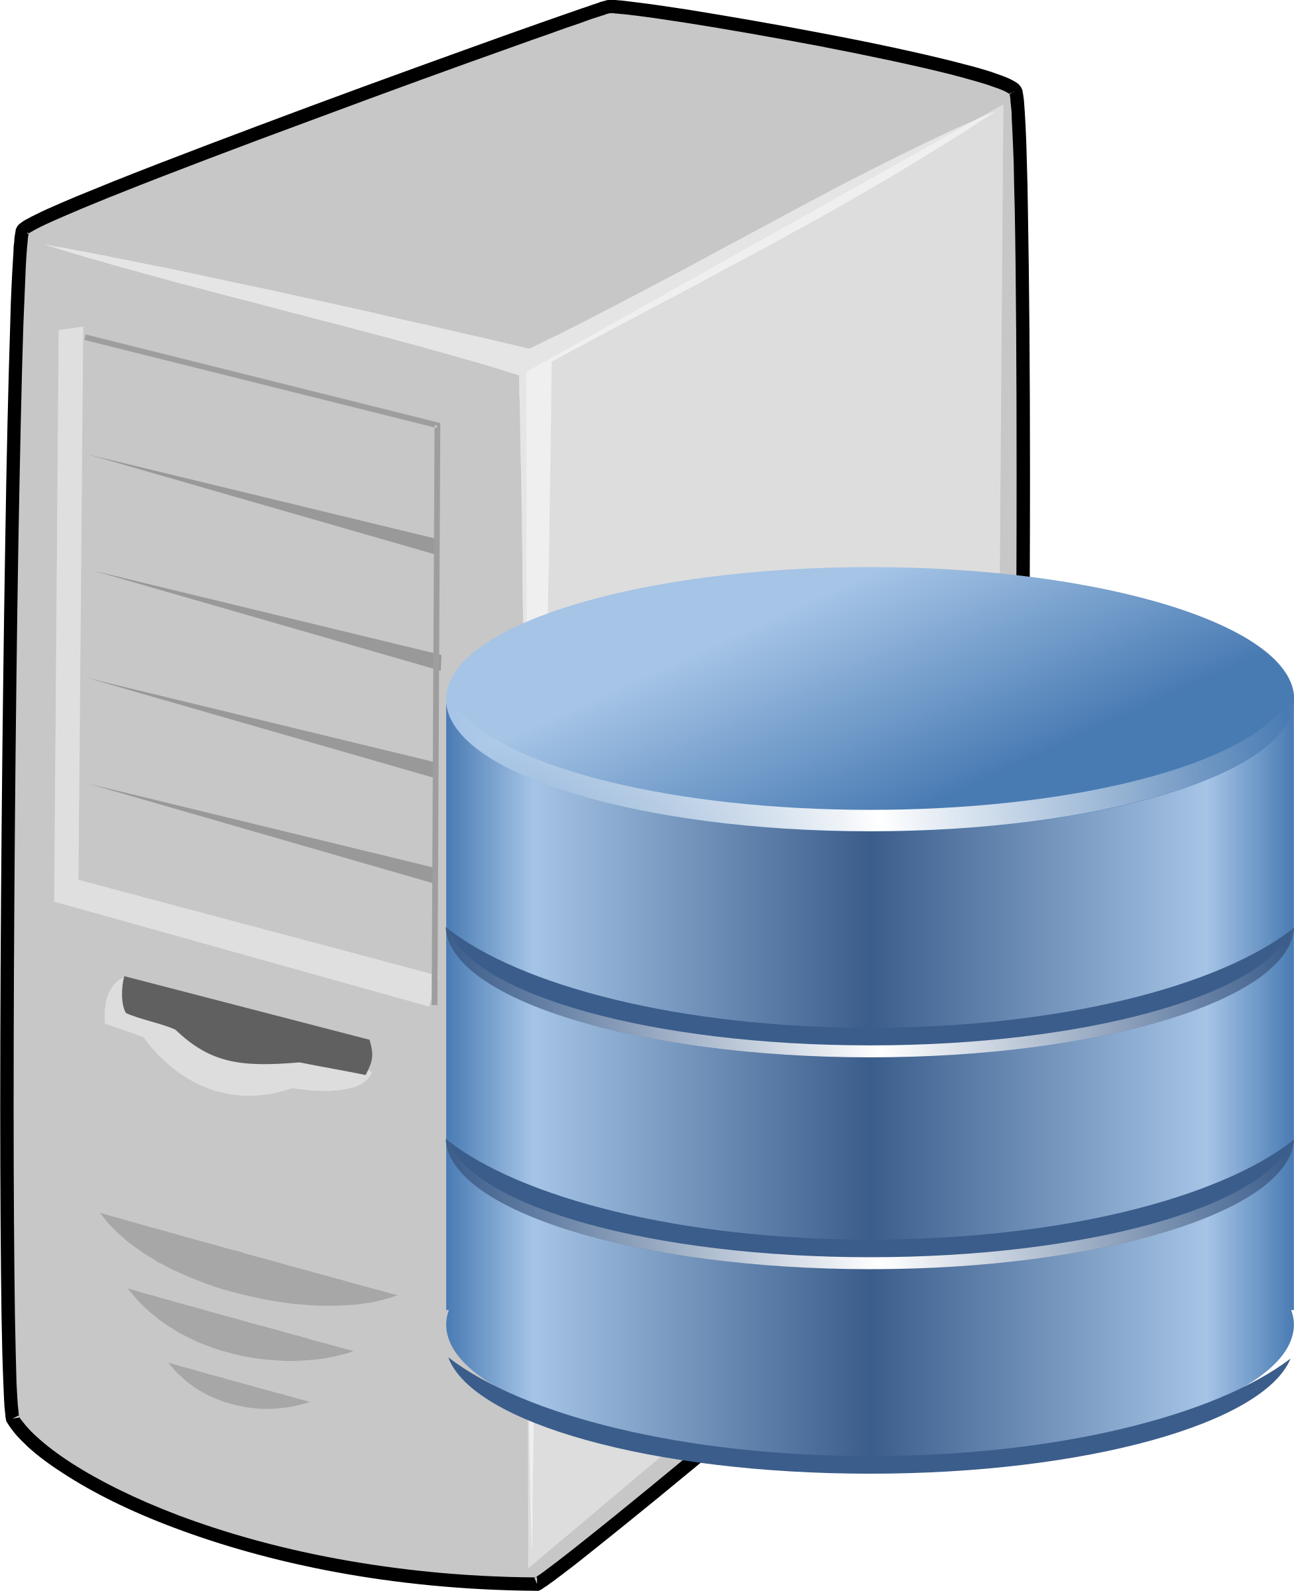
How bad is it?
Is powershell vulnerable?
Developer looks up issue
Internet provides script
Download dependencies
Test if code works locally
Runs code on server

Slide 19
How bad is it?
Is powershell vulnerable?
Developer looks up issue
Internet provides script
Download dependencies
Download dependencies
Test if code works locally
Runs code on server

Slide 20
How bad is it?
Is powershell vulnerable?
Typing mistakes are easy
Malicious code is hard to spot
One time can be enough to cause problems
Once in automation, code isn’t checked

Slide 21
How bad is it?
Is powershell vulnerable?
Other types of attack:
Inject malicious code in popular module
Have machine look at malicious feed
And many more ….

Slide 22
What can we do?
Has someone seen security?

Slide 23
What can we do?
Security
Code scanning and testing

Slide 24
What can we do?
Security
Code scanning and testing
Beware: Data in module manifest can be fake

Slide 25
What can we do?
Security
Code scanning and testing
Beware: Data in module manifest can be fake
Code signing

Slide 26
What can we do?
Security
Code scanning and testing
Beware: Data in module manifest can be fake
Code signing
No checks on claims in manifest or domains

Slide 27
What can we do?
Security
Code scanning and testing
Beware: Data in module manifest can be fake
Code signing
No checks on claims in manifest or domains
Protect and audit your supply chain!

Slide 28

What can we do?
Azure DevOps to the rescue
Download Approved Modules
Only Access controlled Store/Feed
PSGallery
Intermediate Store/Feed
Script
https://learn.microsoft.com/en-us/azure/devops/artifacts/tutorials/private-powershell-library https://azure.microsoft.com/en-us/resources/3-ways-to-mitigate-risk-using-private-package-feeds/

Slide 29
Demo time
Azure DevOps private feeds

Slide 30
What can we do?
Disadvantages
Usage of PAT Token
Automatic Renewal
Service Principal on roadmap for Q1 2023
Maintenance required
Updates less quick in production
https://autosysops.com/blog/automatic-pat-renewal-for-azure-devops https://learn.microsoft.com/en-us/azure/devops/release-notes/roadmap/support-azure-managed-identities

Slide 31
What can we do?
Extra advantages
Control versions of modules
Multiple feeds for multiple environments
Overview of dependencies used
Usage statistics

Slide 32
Thank you for listening!
Questions?
Leo Visser
Twitter: @autosysops
Blog: www.autosysops.com

